Slide 1

KPMG
Realizing Gender Inequality in the Workplace: Unemployment by Region
AI Studio Final Presentation
12/8/2023

Slide 2

Agenda
Team Introduction
Break Through Tech Introduction
Project Introduction
Approach
Data Analysis
Model Results
Reflections

Slide 3
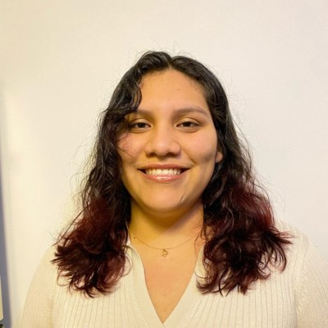




Meet Our Team!
Nicole Sosa New York University
Sreeya Bobby Queens College, CUNY
Trinity Pearl Miller New York City College of Technology
Arnesa Novaj Barnard College, Columbia University
Khadijah Rimawi
Barnard College, Columbia University

Slide 4


Our AI Studio TA and Challenge Advisor
Cindy Deng AI Studio TA, Cornell Tech
Sydney Son Challenge Advisor Lighthouse, KPMG

Slide 5
Break Through Tech Introduction
Break Through Tech (BTT) is an organization founded with the goal of decreasing the gender gap of women and non-binary people within the tech field by providing access to the skills and resources needed, that aren't always offered .
As it stands right now, only 25% of women hold a computing job and hasn’t changed since 2016
BTT offers the following programs to help realize this vision:
Summer Guild
Sprinternship
Breakthrough Tech AI

Slide 6

“
Understanding drivers of gender inequality in the
workplace is the first step toward positive change.
Our goal is to identify drivers of gender inequality, more specifically
female/non-binary, in the workplace in New York City.

Slide 7
Research Question
How do diverse sociodemographic factors subtly shape gender-specific patterns of unemployment within the workforce in New York City?
“According to data from the U.S. Bureau of Labor Statistics (BLS), earnings increase and unemployment decreases as educational attainment rises. Grouping workers by education level, the chart shows that those with more education have higher earnings and lower rates of unemployment than those with less education.” (1)
“Historically, determinants and disparities in health insurance coverage among workers have been well documented, particularly among certain demographic groups, such as ethnic/racial minorities, older adults, unmarried workers, and immigrants” (2)
Notes:
Arnesa Slide
https://www.bls.gov/careeroutlook/2016/data-on-display/education-matters.htm#:~:text=According%20to%20data%20from%20the,than%20those%20with%20less%20education.
“The U.S., employer-sponsored health insurance coverage of Americans aged less than 65 years peaked in 2000 at 67%, and remained high at 57% in 2017 (Su, 2019).
The research question we focused on was: How do diverse sociodemographic factors subtly shape gender-specific patterns of unemployment within the workforce in New York City?
In doing our research, we found that there were many socdiodemographioc factors that contributed to employment. Education is sometimes viewed as an obvious factor, but we wanted to look more closely on the differences between the education levels between females and males vs. their employment rate. As you can see, according to the U.S. Bureau of Labor Statistics“those with more education have higher earnings and lower rates of unemployment than those with less education.”. However, We wondered if it would take women a higher level of education to receive the same employment opportunities as their male counterpart.
Another sociodemographic factor we explored was insurance levels. Although an explicit correlation was not immediately evident, their interconnectedness proved to be something worth researching more closely as unemployment often influences the ability to afford insurance.

Slide 8
Our Approach
Step 1:
Research Question
Step 2:
Data Cleaning
Step 3:
Visualizations
Step 4:
Models
First research question → childcare and maternity leave policies/systems
Final: socio demographic factors shape gender-specific patterns of unemployment within the workforce in NYC
Census Data
ACS 2021 Socio Demographics by Sex
Columns pertaining to 'education levels' and 'insurance'
Independent and dependent variables
Bar graphs, Pie charts, Scatter plots displaying relationships between the independent variable and unemployment levels
Linear regression model
Understanding how each column affects the unemployment levels for each sex (male, female)
Notes:
In our approach, we followed 4 general steps.
Our first task was to identify a research question that could offer practical and valuable insights. This question would serve as a focal point, enabling us to provide accurate information crucial for reshaping workplace policies and fostering greater gender equity.
Originally, our research question revolved around investigating the impact of child care and maternity leave policies on women's reentry into the workforce, with the intent to advocate for policy changes in these areas. However, during the process of data cleaning, we encountered a lack of columns that could contribute meaningfully to our analysis. Due to this reason, we had to revisit our approach and formulate a new research question.
Our current research question as outlined in the previous slide focuses more specifically on socio demographic qualities instead
Our next step involved cleaning the data. Initially, we used the 2020 Census Data, but it lacked the necessary columns for our project. We then found the "ACS 2021 Socio Demographics by Sex" dataset, which included columns on 'education levels' and 'insurance,' better aligning with our research objectives.
In our third phase, we began leveraging our refined data to craft visualizations. Focused on exploring the relationship between various columns, our dependent variable was the "unemployment rate." By employing bar graphs, pie charts, and scatter plots, we aimed to visualize the correlations between our independent variables and the unemployment rate.
In the final step, we proceeded with the model building process. To align with our data and research question, we opted for a linear regression model. This approach allowed us to gauge the strength of relationships between our features and the unemployment rate for both males and females.

Slide 9
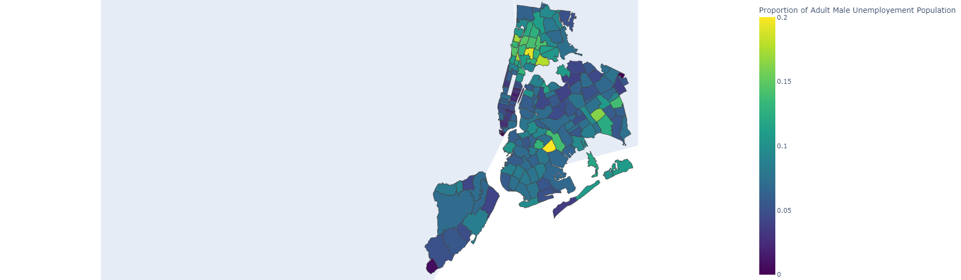
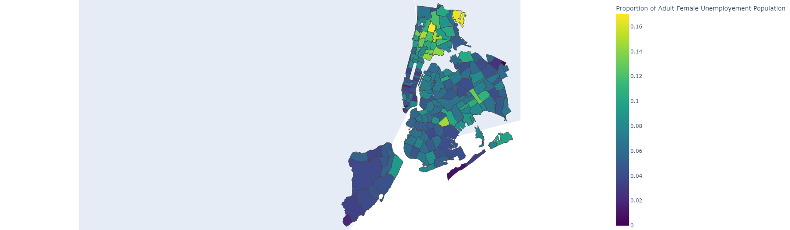
Exploratory Analysis​
Choropleth Maps​ - Dependent Variable
Adult Male Unemployment by Zip Code (%)
Adult Female Unemployment by Zip Code (%)
Notes:
We employed a choropleth map to visualize New York City's unemployment rates effectively. The map vividly illustrates zip codes and neighborhoods exhibiting the highest unemployment levels, depicted in yellow. Notably, for male unemployment, noticeable clusters appear in the Bronx and Queens???. For female unemployment, there is an intriguing pattern as we move further north in the Bronx, with an increasing concentration of yellow-shaded zip codes, indicating higher rates of female unemployment.
Shows geographical view of unemployment by sexes , put some NYC knowledge, female unemployment high in bronx area

Slide 10
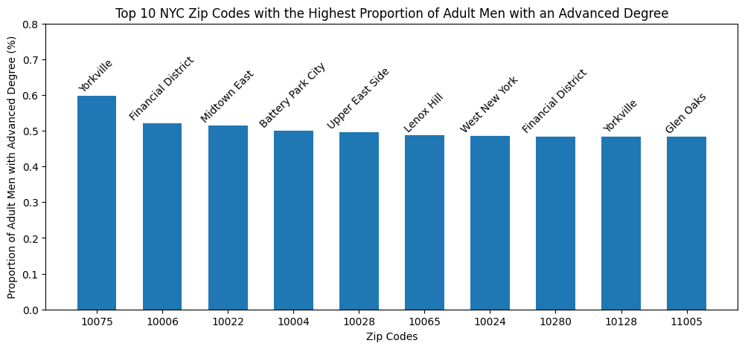
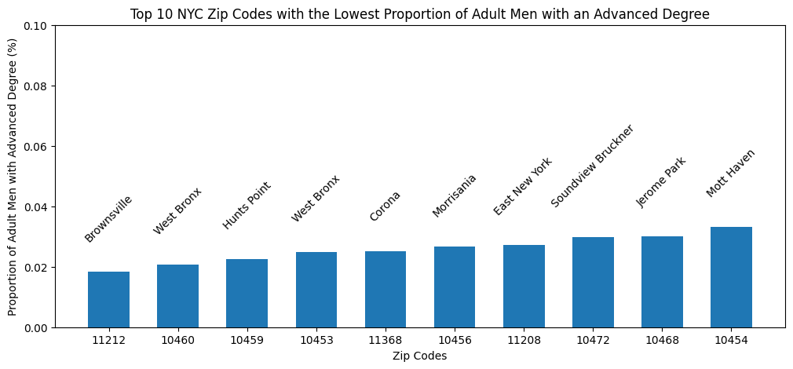
Notes:
While examining the educational attainment proportions across various zip codes, a distinct trend emerged in our analysis. The initial findings showcased a consistent pattern among specific zip codes, revealing differing education levels across boroughs. The first bar graph notably highlighted that the highest concentration of adult men with advanced degrees predominantly resided in Manhattan. Notably, the top ten zip codes were situated in areas like the Financial District and Murray Hill. Conversely, the second graph, portraying the lowest proportion of adult men with college degrees, predominantly featured zip codes from the Bronx, showing a stark contrast. This intriguing pattern prompted us to delve deeper into the correlation between education levels within boroughs and the corresponding unemployment rates across New York City.

Slide 11
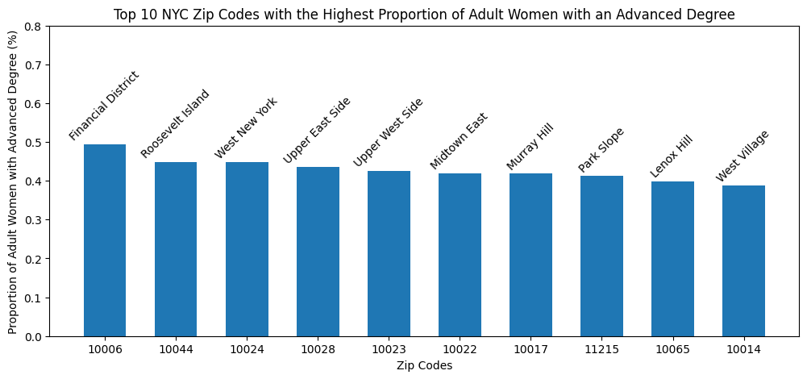
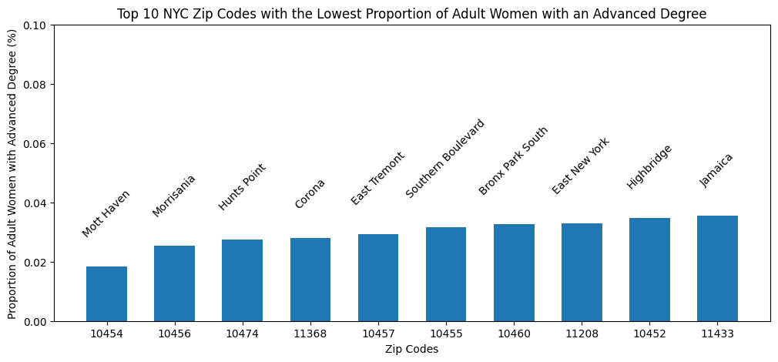
Notes:
This slide offers a similar representation to the previous one. In the first bar graph, the data reveals a concentration of adult women with advanced degrees primarily residing in Manhattan. This trend aligns with the pattern observed in both male and female education levels, showcasing overlapping zip codes such as the Financial District, Murray Hill, and the Upper East Side, underscoring the consistency in educational patterns across genders within specific areas of New York City. As you can see in the second bar graph, there are also overlapping zip codes in the Bronx such as Mott Haven, Morrisania, and Hunts Point.

Slide 12
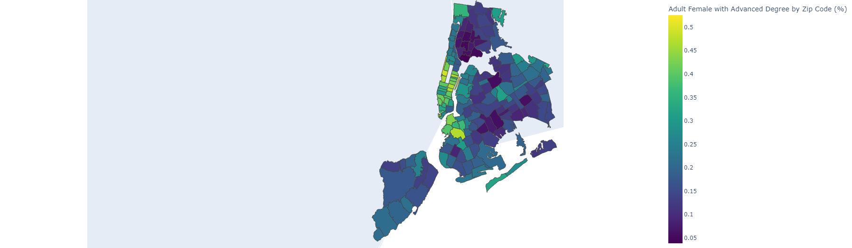
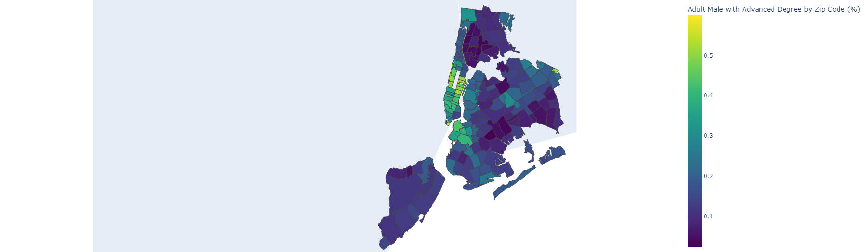
Exploratory Analysis​
Choropleth Maps​ - Education Level (Advanced Degree)
Adult Female with Advanced Degree by Zip Code (%)
Adult Male with Advanced Degree by Zip Code (%)
Notes:
Representation of bar graphs before

Slide 13
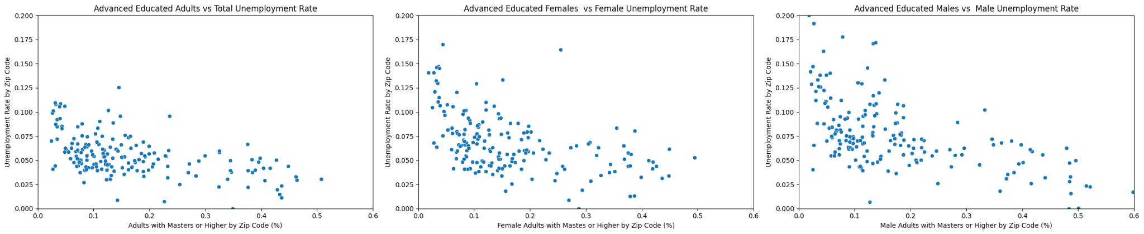
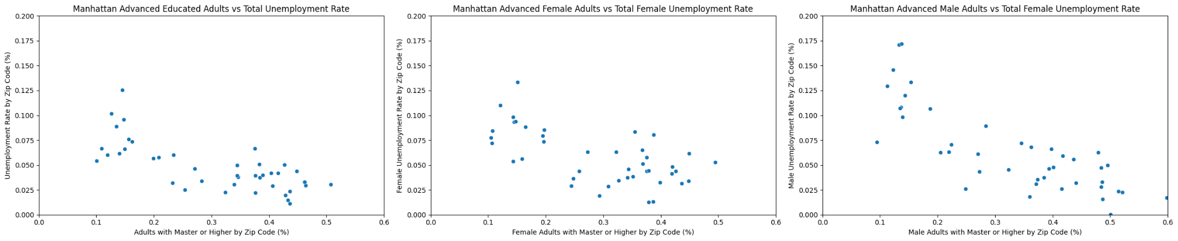
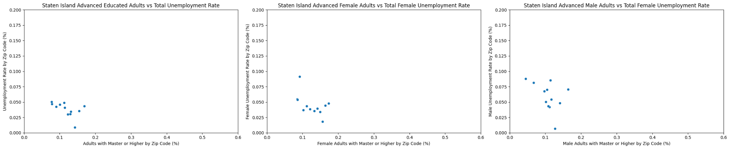
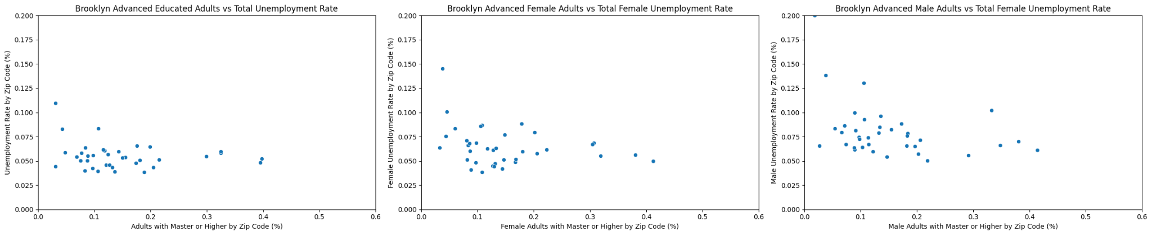
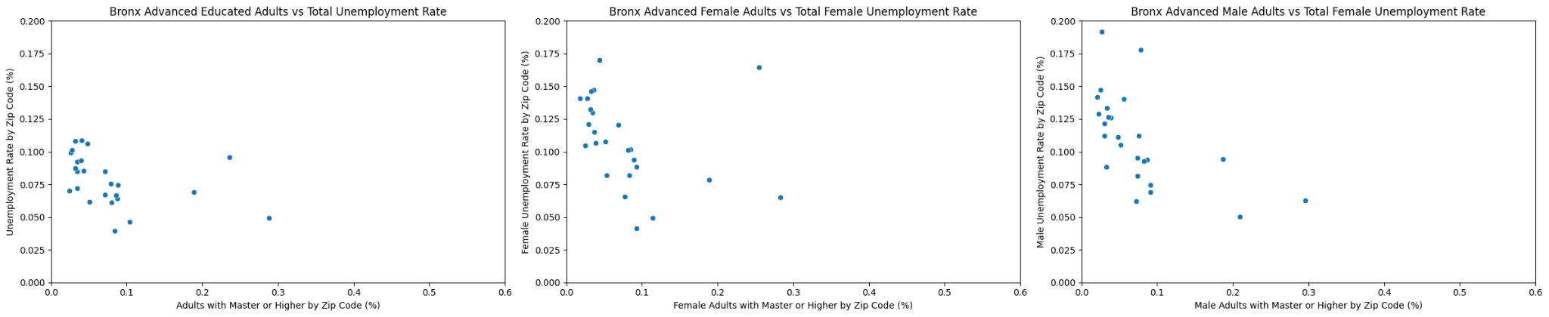
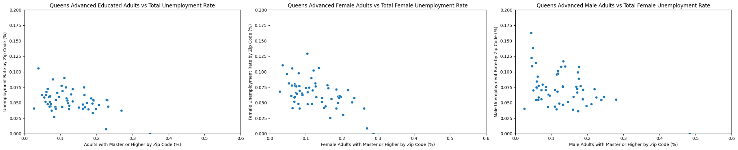
Exploratory Analysis​
Borough Breakdown
Notes:
This slide illustrates the relationship between adults holding advanced degrees and their unemployment rates across the five boroughs. In Manhattan, a noticeable negative correlation exists, indicating lower unemployment rates among individuals with advanced degrees. The Bronx displays an interesting cluster, prompting a closer examination. Given these findings and the patterns from previous graphs, we've chosen to delve deeper into Manhattan and the Bronx for a more focused analysis.

Slide 14
Exploratory Analysis​
General Population Breakdown
10464: Pelham Bay Park
Notes:
Initially, we examined the general adult population holding an advanced degree. Across all three graphs, a clear negative correlation emerged: as the population with advanced degrees increased, the unemployment rate tended to decrease. While this pattern was anticipated, we observed outliers in certain scenarios. For instance, despite around 0.2% of the female population possessing a master's degree in a specific zip code, a notably high level of unemployment persisted. Similarly, within the male scatterplot, although less pronounced, certain zip codes with approximately 0.15% of the male population displayed elevated unemployment rates, indicating the presence of outlier trends.

Slide 15
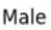
Exploratory Analysis​
The Bronx
Notes:
In The Bronx, the scatter plots illustrate a pattern clustered towards the left side, indicating a lower proportion of the adult population holding advanced degrees in several zip codes. Despite this, the relationship between education levels and unemployment rates in certain zip codes is worth noting. In the scatterplot concerning female adults, even when a zip code exhibits a higher percentage of women with advanced degrees of over 0.25 percent, it still coincides with a high unemployment rate of around 0.17 percent. This trend is more pronounced in The Bronx, where multiple zip codes consistently correlate with elevated unemployment rates despite varying education levels among adults.

Slide 16
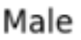
Exploratory Analysis​
Manhattan
Notes:
In Manhattan, there is a clearer negative correlation: as the proportion of adults holding an advanced degree increases, the unemployment rate tends to decrease. This pattern appears consistent among both males and females. Manhattan was specifically chosen due to the consistent trend observed in the bar graphs, where it was consistently featured among the zip codes with higher education levels for both genders. In analyzing data in Manhattan more closely, it is important to note that it offers advantages like proximity to diverse job opportunities and professional development options. These factors could contribute to the lower unemployment rates, particularly for individuals with advanced education levels. Thus, higher education, particularly in areas like Manhattan, is crucial as it aligns with the demands of the diverse job market in the urban landscape.

Slide 17
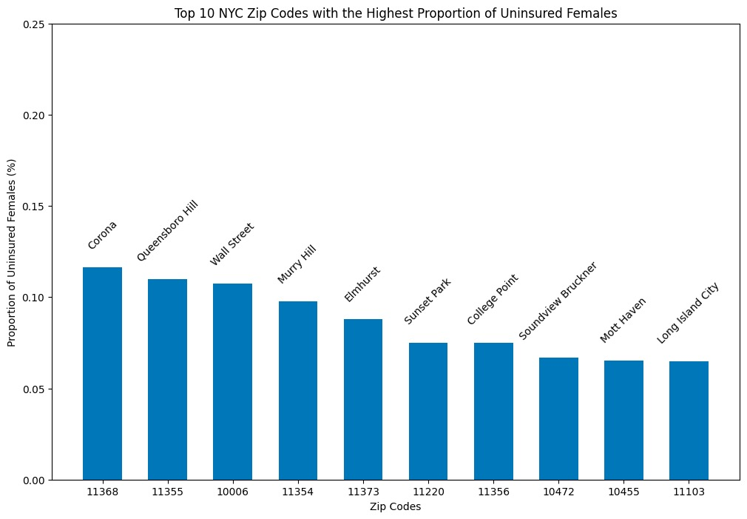
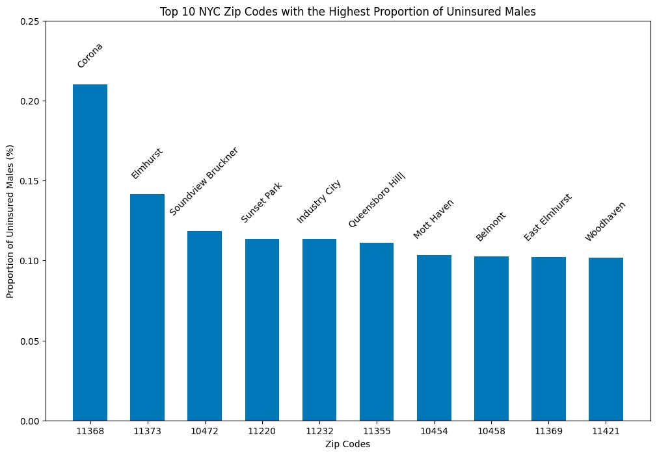
Exploratory Analysis​
Highest Proportion of Uninsured

Slide 18
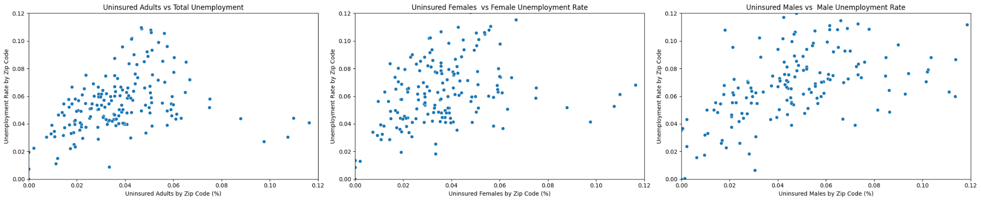
Exploratory Analysis
Uninsured vs Unemployment

Slide 19
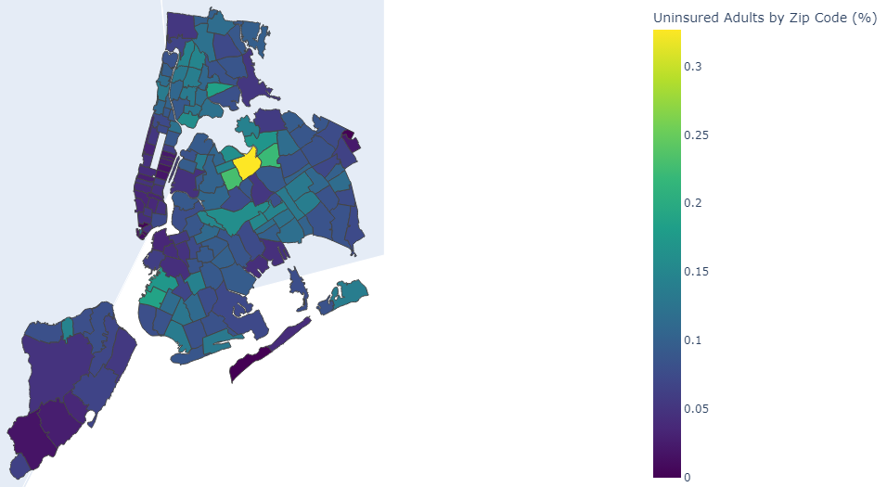
Exploratory Analysis​
Choropleth Maps​ - Uninsured Adult Breakdown
Uninsured Adults by Zip Code (%)
Notes:
Yellow corona

Slide 20
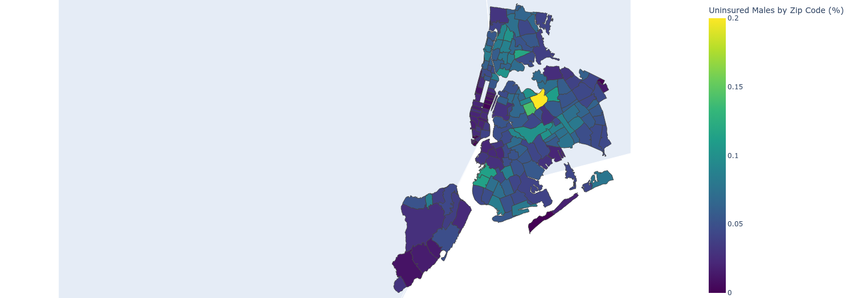
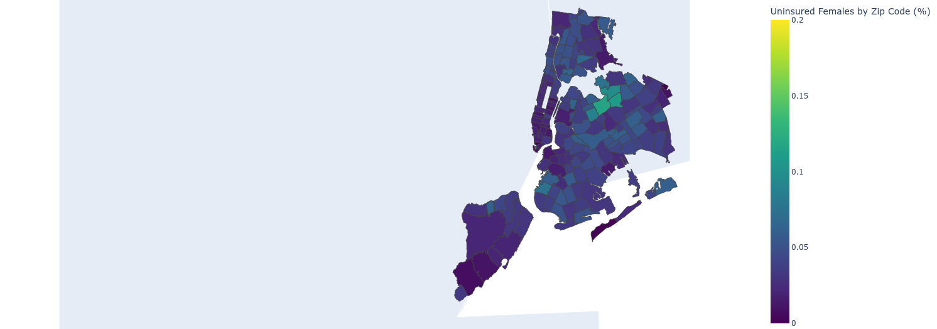
11368
zip code for arrows: 11373 (orange), 11373 (pink? lol), 11354 (yellow), 11355 (light blue)
Uninsured Males by Zip Code (%)
Uninsured Females by Zip Code (%)
Notes:
Fix the scale to 0.2

Slide 21
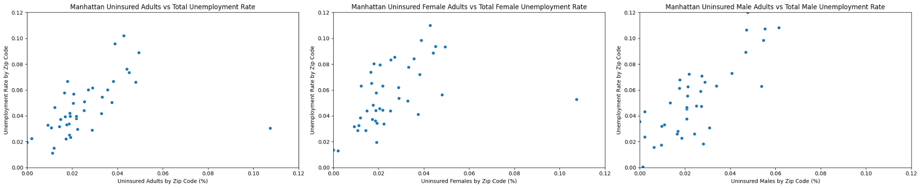
10006: Wall Street

Slide 22
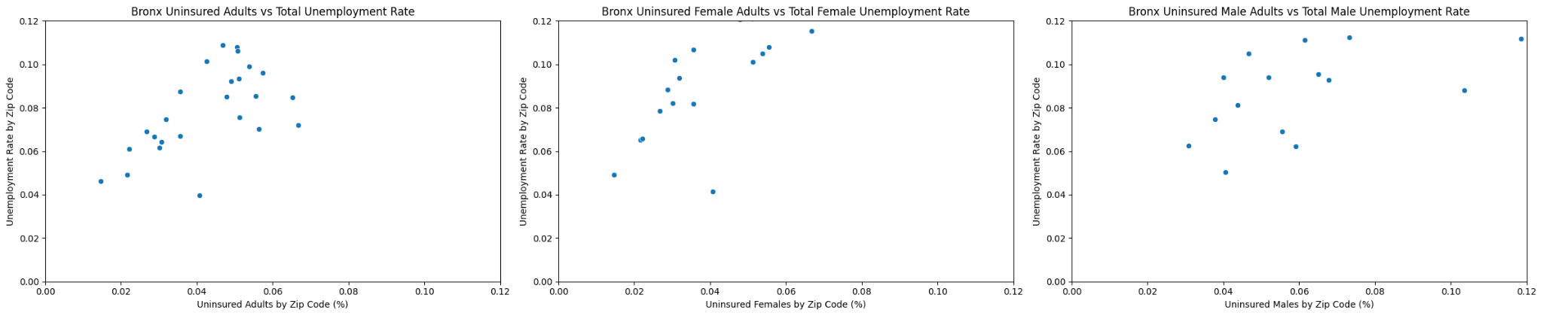
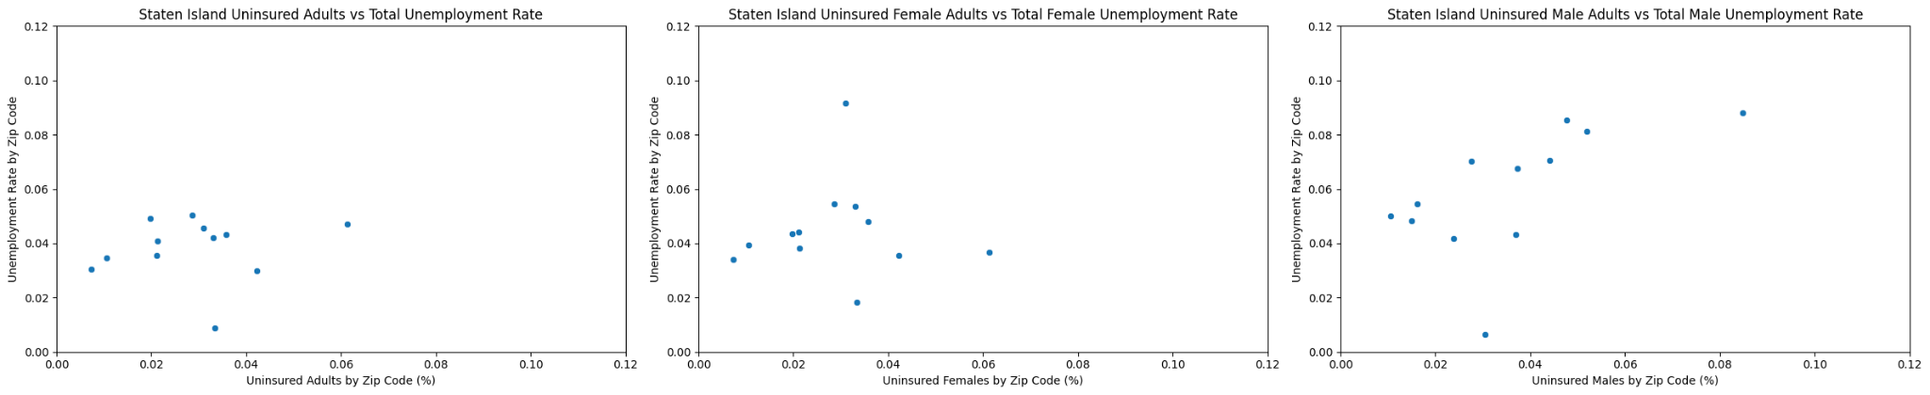

Slide 23
Modeling Process
Model Choice: Multiple Linear Regression Model
Iteratively developed regression models, for male and female sexes, to see if the features have varying degrees of influence in each sex’s unemployment rate
Develop a Vanilla Model
Analyzed Results
Improved Features
Key Findings
Features for both sexes:
Percentage of males/females without health insurance
Percentage of males/females with a certain education level (i.e. high school)
Percentage of male / female of a certain age (i.e. 18 -19 yrs)
Dependent variable
Males/females unemployment rate
Check each feature statistical significance
( P-value)
Explored correlation between features to see if there is a high chance of collinearity
Combined/grouped features
Removed unnecessary features
Percentage of males/females without health insurance
Percentage of males/females of a certain age
Education levels were the most significant features that impact unemployment rate for both sexes
Strongest feature for both males & females: below high school education
Runner up for both males & females: some college/associate education
Notes:
As for our modeling process, we chose a multiple linear regression because we wanted to explainable model. What I mean by this is that as we iteratively began developing the regression model for both male and female sexes, we really wanted to see if the factors we chose for the models have varying degress of influence in each sex’s unemployment rate
To start that off, we develop a vanilla model. This vanilla model contains all 21 features we thought could be contributing factors to each sexes unemployment rate. All the features used in one model was also use its the other model.
Below highschool education : taking about elementary, middle eschool, essentially anyone without a highschool diploma education
college/associate education : talking about a year or 2 of college, or an associate degree
I will go into more specific details about how these features increase unemployment rate in the following slides
So after developing our vanilla model we analyzedx results
P-value tel you what is the probability of observing the null hypothesis ( no difference in the way the features influence each sexs unemployment rate, we should be expecting identical results for both models) , we set it our threshold to be 0.05 5% , the null hypothesis has a 5% chance of being true;
Linear regression model (explainable model, we didn't not want to predict, we wanted to find if there were some factors that could explain the unemployment rate for women)
Used a total of 21 features for this vanilla model
Through our research and visualization, we noticed some features we thought would be strong indicators for unemployment rate and then additional features we chose to use were based on hierarchical knowledge, people of certain age experiences more unemployment rate etc, but after running the first model with all of these features these were the results
We wanted some stronger, and the more features we used, not the best if we could just as good with less features so from where we noticed that a lot of the age not useful so we took all of them away and just keep insurance and education information and this is what we found
We did the same for men as well from both iteration in both men and women
We used percentage for features for normalizations reasons

Slide 24
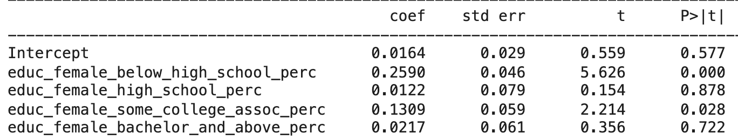
Model Findings (Female)
R^2 = 0.425
Key findings:
Approximately 42.5% of the variations in female unemployment rate can be explained by the education features in the model
A 1% increase in the percentage of females with a “below high school education” can lead to a 0.2590% increase in female unemployment rate
A 1% increase in the percentage of females with “some college/associate degree education” leads to a 0.1309% increase in female unemployment rate
Percentage of females with “high school education” and “bachelor and above education” didn’t show a significant impact on female unemployment rate
Notes:
Like before both percentages of females with

Slide 25
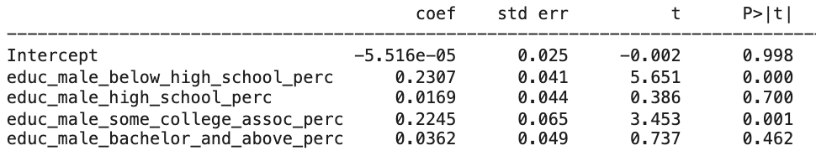
Model Findings (Male)
R^2 = 0.432
Key findings:
Approximately 43.2% of the variations in male unemployment rate can be explained by the education features in the model
A 1% increase in the percentage of males with a ”below high school education” can lead to a 0.2307% increase in male unemployment rate
A 1% increase in the percentage of males with “some college/associate degree education” leads to a 0.2245% increase in male unemployment rate
Percentage of males with “high school education” and “bachelor and above education” did not show a significant impact on male unemployment rate
Notes:
Maybe include information

Slide 26
Final thoughts on Model’s Findings:
Below high school education feature: drives the highest unemployment rates increase for males (coef: 0.2307) and females (coef: 0.2590). The difference shows having a high school degree has stronger impact for females
Some college/associate education feature: drives the second highest unemployment rates increase for males (coef: 0.2245) and females (coef: 0.1309). The difference shows having a college degree has a stronger impact for males
Both features impact male and female unemployment rates similarly, but the strength of the impact is different, which shows there are distinctions in how these educational factors influence unemployment rates for males and females
Next steps, delve deeper into the complex relationship between education and unemployment
Notes:
Impact of having hs degree is more important for women this 0.02 difference
Having a bachelor degree is more important t
They impacted them the sway, the strength of impact is difference
The impact of having some
Maybe include information
This is something we wanted to see, we wanted to see if there was a difference in the impact each factor has for each sexes model and small there is a difference
We want to understand if same factors play a same role to each sexes unemployment rate. Your hypothesis is that they exactly the same.
This is what you say :
This variation we wanted to see because if there was no underlining difference between the two, no difference in how society treats men and women
Use more data or other data, for our case we use census data only for 2021 but maybe we could use 2022 and more see if this finding remain the same or no

Slide 27
Business Impact
KPMG's commitment to gender equality aligns seamlessly with our model, which highlights the pivotal role of education and health insurance in women's employment.
Building upon KPMG's 2022 Impact plan, we recommend focusing on targeted education and training programs to empower female employees, fostering career growth and advancement.
Additionally, investing in comprehensive health and wellness initiatives ensures that women have access to the necessary support and resources, including robust health insurance coverage and family-friendly policies.
By using our model's insights, KPMG can implement these initiatives to create a workplace that not only upholds gender equality but also actively addresses factors influencing women's employment. This approach aligns with KPMG's ongoing efforts to create a more inclusive and equitable global workforce.
Notes:
https://kpmg.com/xx/en/home/insights/2022/03/our-impact-plan-people.html (2022 impact plan)
KPMG strong dedication to gender equality and help bring this around world -> our explainable model will help them have more targeted solution
Additionally, doing this increases GDP, according to this article “Countries that Close Gender Gaps See Substantial Growth Returns”, Article written by the International Monetary Fund on September 27th, 2023
Add bullet point education is important tie back to research and analysis

Slide 28
Reflections
One major takeaway from the project was recognizing that a majority of machine learning involves a trial-and-error approach. Contrary to our initial assumption that the modeling portion would be the most tedious, we found that the data-cleaning process was one of the most iterative for the team.
This project empowered us by immersing us in the practical aspects of addressing workforce inequity through data-driven methods. It provided us with a holistic perspective, covering everything from understanding the data to creating meaningful insights and utilizing it in the creation of our models. This collective experience not only enhanced our technical skills but also instilled in us a sense of responsibility and purpose, motivating us to contribute to meaningful change.
Notes:
-you can rename the slide but the purpose of the slide is to explain how we came up with the research question, back it up with research (literature reviews), and explain the general importance of this question and what our model will ultimately do. Nicole will be talking about the business impact so you don’t have to cover that here. Thx.

Slide 29

Questions?

